Slide 1

Making a Personal Impact Metrics Playbook
Erin, Juan, Julian, Mandy, Matty
December 5th, 2016

Slide 2
Table of Contents
Section | Page
Proposed Approach | 4
Short Term: User Segment | 9
Short Term: Performance Metrics | 13
Short Term: Baseline Survey | 19
Mid Term & Long Term: Decision Matrix | 26
Long-Term: Culture of Measurement | 30
Implementation Plan | 35
Appendix 1: Survey Examples | 38
Appendix 2: Benchmarking | 43

Slide 3
BCO Metrics Challenge: Summary
BCO brings a global brand and capabilities to serve its users
…but there are opportunities within the personalization process to improve measurement
Recognized leader as source of scholarly breast cancer information
Opportunities to expand impact through enhanced user experience in the long-term
Global loyal user base
Ability to drive wider range of users to engage with the personalization solutions
Use of operational metrics to measure current site usage
Enhanced metrics to measure results in the short-term using surveys
Existing basic personalization platform
Expanding reach and enhancing personalization offerings
BCO sought approaches to measure performance of their personalization platform

Slide 4
Proposed Approach

Slide 5

Section Summary
We propose a Personalization Journey as the overarching concept with discrete phases in the short, mid, and long term.
Metrics across this journey are assessed based on the strategy and operational model we anticipate across each phase.
Our deliverables focuses on delivering a playbook that provides specifics steps on operationalizing short-term metrics and provides insights for mid and long term metrics decisions

Slide 6
The Personalization JourneyAwareness
One-To-One Personalization
Automation & Targeting
Use of predictive analytics to provide specific diagnoses and health and wellness recommendations to drive desirable outcomes
Build digital tools to automate targeted information (beyond only articles) tailored to different segments
Enhanced Awareness
Tag relevant articles and leverage community forums for users to take action towards treatment and lifestyle choices
Metrics Maturity
Current Focus
Time
Short-Term 12 months
Mid-Term
1-3 Years
Long-Term
3+ Years
Notes:
Strategy exploring different operating models in mid-long to long-term. Much is still unknown (Oxeon, etc.). We wanted to set foundation in the short-term.

Slide 7
Metrics within the Personalization Journey
Metrics maturity will be based on the personalization strategy and operational models that are established along the journey. Metrics should inform further strategic moves and operational models.
Enhanced Awareness
Automation & Targeting
One-to-One Personalization
Personalization Strategy
Define shared vision
Clarify expected outcomes
Benchmark business models
Establish user segment approach
Determine adjustments to theory of change
Identify new capabilities and establish strategic plan
Personalized and automated diagnosis recommendations on plans
1 to 1 tailored dialogue with each user through health coaches
Personalized tracking of goals
Personalization Operational Models
Enhance current webpage
Evaluate operating model to grow organization
Determine future digital platform
Build algorithmic capabilities that generate automated recommendations
Develop user communications and internal training
Increase back-end data management
Culture of constant testing and innovation
Multichannel digital platforms allowing different user touchpoints
End-to-end master data management capabilities
Personalization Metrics
Define key performance metrics
Apply tools to collect measurements
Operationalize measurement tracking
Define metrics for new operational model
Establish master data and reporting structure
Establish a metrics dashboard w/ delivery to stakeholders
Data warehouse widely available to pull reports on-demand
User friendly interfaces for reporting progress on metrics
Tailored metrics reports to various stakeholders
Short-Term 12 months
Mid-Term
1-3 Years
Long-Term
3+ Years

Slide 8
Final Deliverable: Metrics Playbook
The team will structure the final deliverables to provide metrics recommendations for the current strategy and operational model with recommendations to prepare for the Personalization Journey
Short-Term 12 months
Mid Term & Long-Term
Deliverables to help maximize performance of the current personalization site
Deliverables to work as BCO advances on its mid and long-term strategy
Metrics Methodology & Strategy
Refreshed current state logic model
Outcomes definition – specific activities
Recommendations for user segments
Definition of metrics to track outcomes
Recommendation on how to phase work towards long-term
Proposed methodology to evaluate different operational models
Exploration of different patterns and functionalities of personalized platforms
Applied
Tools
User interviews
Survey outline and process
Implementation plan
Benchmarking on similar personalized models
Decision matrix
Roadmap for building a culture of measurement

Slide 9
Short Term User Segments

Slide 10

Section Summary
Creation of different user segments based on content preferences
Assignment of types of metrics to each user segment
Considerations for BCO as they move forward with these segments in mind

Slide 11
Short-Term 12 months
Current State Segment Breakdown
 | Information Researchers | Emotion Supporters | Decision Makers
Needs from Personalization | Gain comfort from reading as much as they can Seek out evidenced-based research and articles -- “information carnivore” Priority is research and information gathering | Feel most supported by hearing about the experiences of others Seek forums for sharing experiences Come to BCO for comfort | Motivated by taking control of her diagnosis Seeks information in any format that will allow her to make the most informed decisions
Content Preferences | “Hard” content: original research, journal articles, evidence- based papers | Forums, community boards, “safe spaces” where they can commiserate with others | Easily digestible content
Measurement Considerations | Measure through wellness score--how much stress alleviation did they get from research conducted on BCO | Wellness score more indicative of site’s value than actions taken | These individuals are likely to change their behavior based on what they encounter

Slide 12
Segmentation Considerations and Testing
As BCO moves forward with the different user segments there are various considerations the leadership team should keep in mind:
Considerations
Testing Methodology
How can BCO content be personalized based on user preferences for certain types of material?
How can BCO choose metrics to keep track of that will be meaningful for all segments?
How can BCO make different types of content more accessible to users?
Testing a “content preference” question on the form that users fill out when they are signing up for personalization
Using the survey to test what metrics are trackable for the different segments--thinking beyond behavior change and including questions regarding wellness
Testing making the personalization program more visible on the homepage and via e-mail

Slide 13
Short Term Performance Metrics

Slide 14

Section Summary
We developed a logic model that reflects the current state of BCO’s operations and can serve as the foundation of BCO’s measurement strategy
We recommend focusing on metrics that link outcomes to mission and intended impact based on empirical research
We propose a short-term metrics framework that prioritizes evidenced based metrics and can evolve with the measurement capabilities of the organization

Slide 15
Short-Term 12 months
Current State Logic Model
Inputs | Activities | Outputs | Outcomes | Impact
External Users Survey Form Articles Account Info Pathology Report Internal Mgmt Staff Technical Staff Content Staff Platform Marketing Maintenance Reporting Funding | Users complete survey Articles are meta-tagged or negative tagged Users complete E-profiles Users participate in community forums | # of users reading tagged articles # of active users # of non-active users # of users updating profiles # of users providing and reading community entries | Action users have taken towards treatment Action users have taken towards lifestyle decisions Stress reduction / well-being | Reducing rate of breast cancer incidence Improving health outcomes for breast cancer patients

Slide 16
Defining Outcomes
Research Findings
Outcomes that help women achieve the best health outcomes and reduce occurrence
Personalization Outcomes To Track
After menopause, being overweight or obese increases breast cancer risk. American Journal of Epidemiology
Medical knowledge
Confidence
Clarity (ex. understanding of diagnosis)
Comfort (ex. reduced fear of unknown, stress, sleeplessness)
Weight management
Diet
Exercise
Sleep
Medication adherence
Social connections
Treatment decision
Quality of life
Weight Management
Medical Adherence
Only 49% of patients with BC took adjuvant hormonal therapy for the full duration at the optimal schedule. Early discontinuation and non-adherence to hormonal therapy were common and associated with increased mortality in early stage breast-cancer patients. Journal of Clinical Oncology
Quality of Life
“I desired to know everything I could possibly know.”
“The unknowns of cancer are the hardest part.”
{Users value the information as well as the shared community of people with common experiences}
We recommend focusing on metrics that link outcomes to mission and intended impact based on empirical research

Slide 17
Defining Outcomes
Research Findings
Outcomes that help women achieve the best health outcomes and reduce occurrence
Personalization Outcomes To Track
After menopause, being overweight or obese increases breast cancer risk. American Journal of Epidemiology
Medical knowledge
Confidence
Clarity (ex. understanding of diagnosis)
Comfort (ex. reduced fear of unknown, stress, sleeplessness)
Weight management
Diet
Exercise
Sleep
Medication adherence
Social connections
Treatment decision
Quality of life
Weight Management
Medical Adherence
Only 49% of patients with BC took adjuvant hormonal therapy for the full duration at the optimal schedule. Early discontinuation and non-adherence to hormonal therapy were common and associated with increased mortality in early stage breast-cancer patients. Journal of Clinical Oncology
Quality of Life
“I desired to know everything I could possibly know.”
“The unknowns of cancer are the hardest part.”
{Users value the information as well as the shared community of people with common experiences}
We recommend focusing on metrics that link outcomes to mission and intended impact based on empirical research

Slide 18
Short-Term 12 months
Short-Term Metrics Framework
Anticipated Outcomes
Specific Outcomes
Examples of Specific Metrics
I. Actions for Treatment
Motivation to engage with doctor & treatment plan
Clarity
Medication Adherence
Patient activation
Understanding of:
Diagnosis
Prescribed medications
Available treatments
Treatment side effects
Important factors in making decisions about treatments
Ability to remember medications
Satisfaction with medication
Start new treatment
Change treatment
II. Actions for Lifestyle
Weight Management
Knowledge of important lifestyle factors (ie. diet, exercise, and sleep)
Ability to maintain lifestyle changes (ie. diet, exercise, and sleep)
III. Stress Reduction
Quality of Life
Confidence
Self reported health status
Confidence in ability to figure out solutions when health problems arise
Confidence to deal with challenges (stress, money, etc) caused by diagnosis
Confidence in discussing concerns with doctors

Slide 19
Short Term Baseline Survey

Slide 20

Section Summary
Considerations for organization and audience parameters of a user survey
Draft of user check-in survey and methodology for delivery
Survey strategy and best practices to create an interactive and educational survey process

Slide 21
Survey Parameters
Audience
# of questions
Frequency
Invitation format
# of reminders
Organization
Cost
Time
People
Process (implement, analyze, share out)

Slide 22
Survey Methodology
Strategic surveys delivered at regular intervals (biannually or quarterly) by email and posted in discussion boards and on social media
<10 questions, progress bar and link to results at the end
Not anonymous in order to connect to profile data and underscore partnership
Creating a copy of the survey for each posting location so that the results can be differentiated by where the user interaction took place (email, discussion board, home page, social media etc)
Surveys could be hosted on website, though free web tools may be more flexible, rapid and intuitive for users

Slide 23
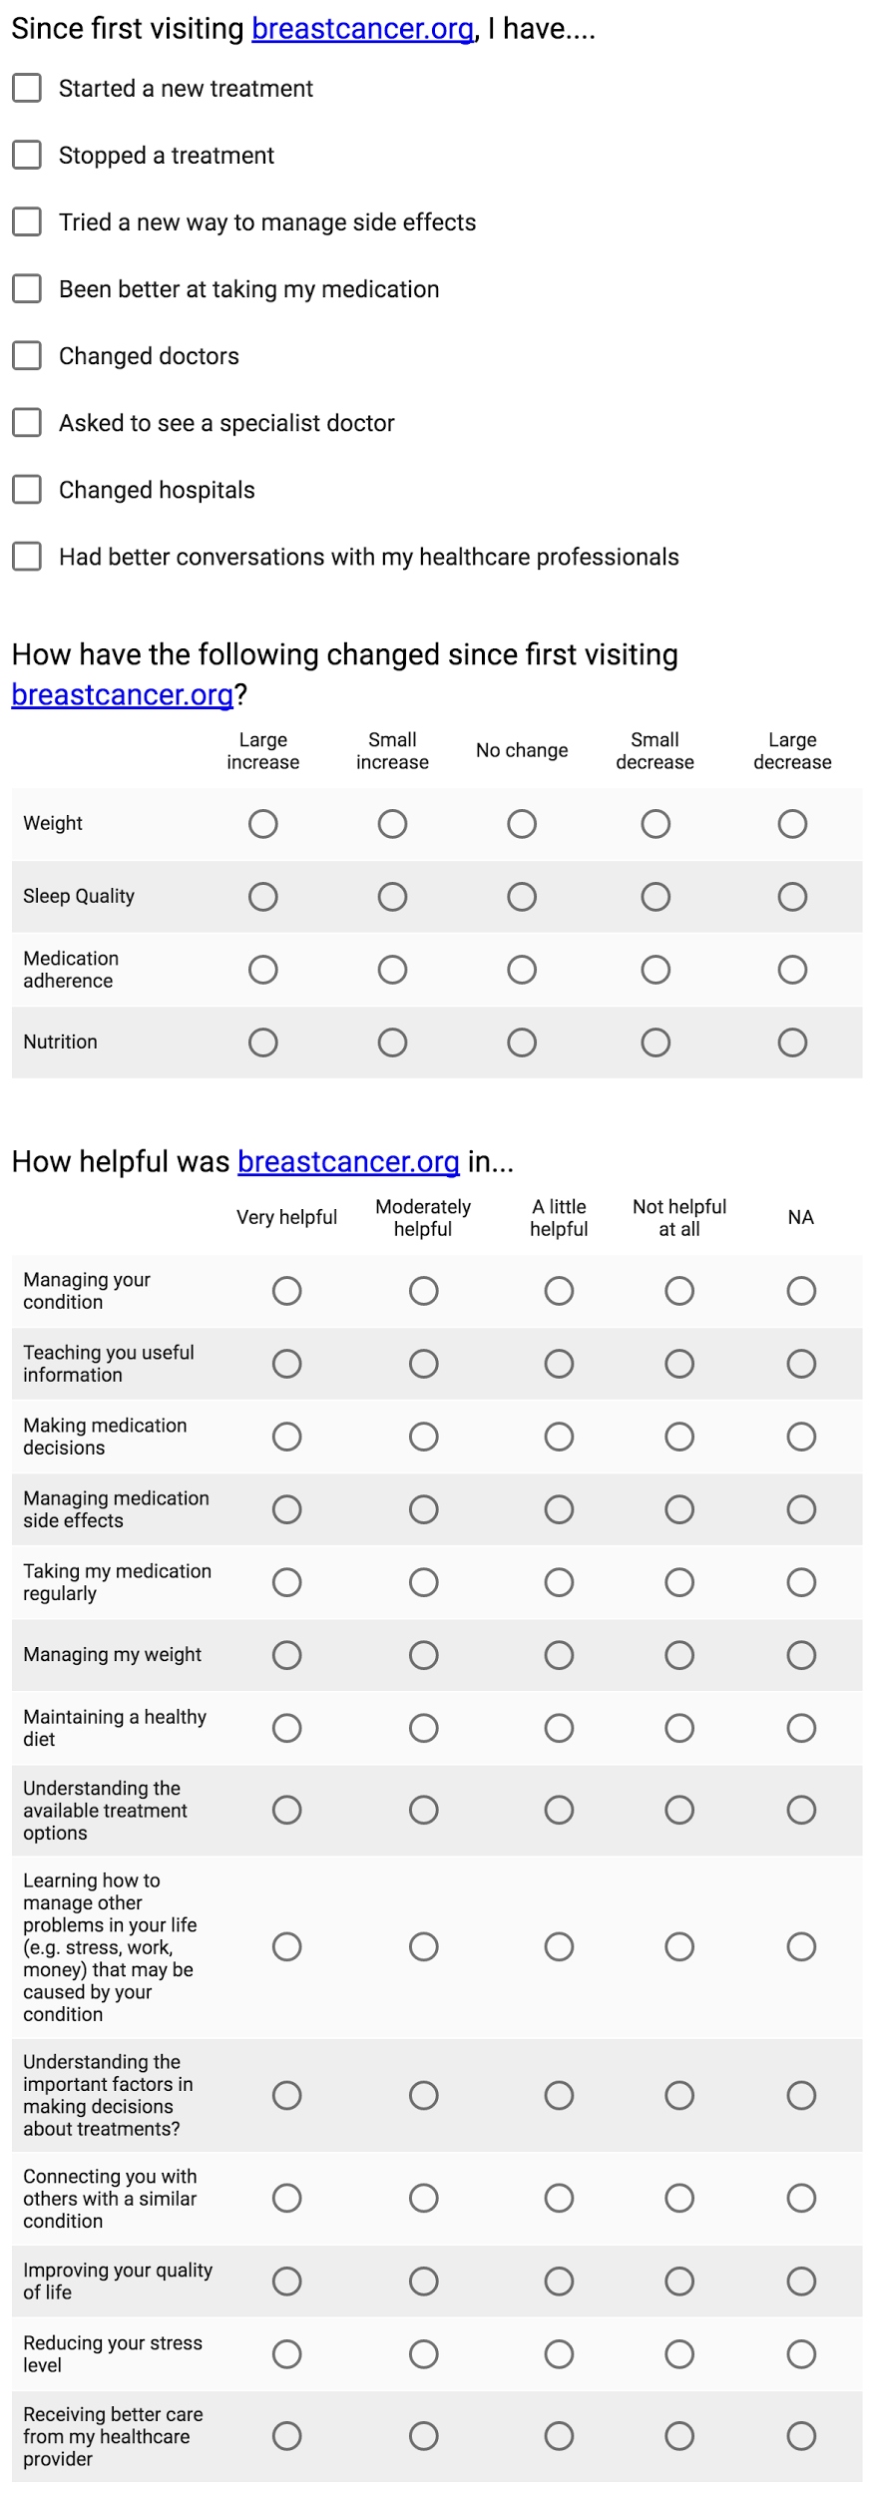
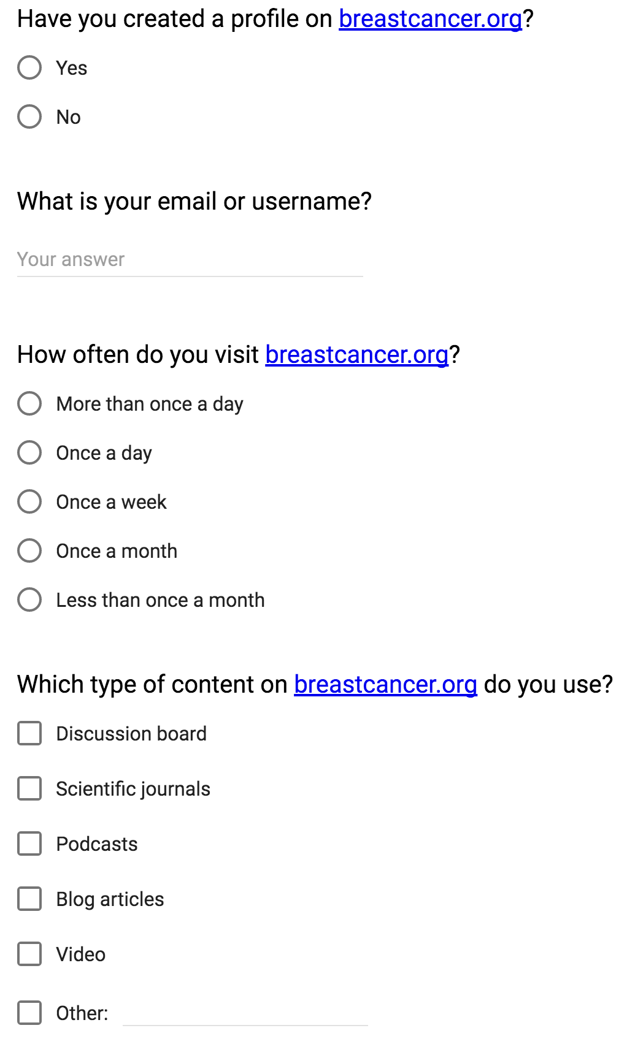
Draft Survey
Modify this question to gauge whether visit was organic part of treatment or interaction with BCO prompted action.

Slide 24
Drafting a Survey
Determine what outcomes/actions to track
Cultivate list of potential questions that might be indicative of actions or serve as proxies
Draft initial survey
User test survey for clarity and relevance of questions
Email out to all users with brief explanation of goals, introducing idea of partnership with organization to improve quality of service and assuring privacy

Slide 25
Continuous Learning Process
Before sending out each survey, review the available data
Make adjustments to content, format and delivery as necessary based on response data and feedback
Evaluate aggregate response trends over time as well as between users
LEARN
BUILD
MEASURE

Slide 26
Mid Term & Long Term
Decision Matrix

Slide 27

Section Summary
We propose some guiding principles to assess the different operational models BCO is considering
Those operational models can be evaluated based on mission alignment and financial contribution
Mission alignment can be assessed by analyzing integrity, mission fit, reputation, and the fit with a non-profit culture
Financial contribution can be assessed using traditional financial metrics

Slide 28
Dual Bottom-Line Matrix
Requires Subsidy
Clear Winner
We propose a matrix to rank and classify the operational alternatives that BCO will face in the next following months.
The financial contribution can be measured by hard financial data on revenue, return, among others.
The mission alignment can be measured by the mission fit, integrity, reputation, and non-profit culture as we propose in the next slide.
High
Mission Alignment
Potential Distraction
Generates Subsidy
Low
Negative
Financial Contribution
Positive
Source: Copen, B (2014) Asian Americans for Community Involvement (ACCI): A Strategic Inflection Point. Haas Case Series

Slide 29
Assessing Mission Alignment
Integrity
The alternative is ethical and preserves the core values on which BCO was established
Mission Fit
The alternative creates a significant impact in reducing breast cancer incidence
Reputation
The alternative preserves the reputation of Breastcancer.org, Founder, and Staff as rigorous members of the scientific and non-profit community
Non Profit Culture
The alternative preserves BCO’s non-profit vibe, which creates a strong sense of mission and innovation
Source: Conversation with Doctor Marissa Weiss (Nov 7, 2016)

Slide 30
Long Term
A Culture of Measurement

Slide 31

Section Summary
BCO is building an organization that puts the highest value on evidence-based decision making
We are proposing a pathway for this work, using the 3 phases of The Personalization Journey, broken down into:
Process: formal connections and rules
Tools: practical elements
People: communication, incentives, and training
Advancing in those dimensions will help BCO advance in this challenge in a holistic and sustainable way

Slide 32
Building a Culture of Measurement
Phase 1: Enhanced Awareness
Process
Create basic procedures to collect data from the survey and report results
Incorporate survey results into leadership meetings
Tools
Implement basic survey
Connect survey with web platform
Create basic reporting tools using Excel
People
Kick off: The Personalization Journey and The Metrics Playbook
Run an Internal communications campaign
Formalize a role in charge of the measurement process
Train staff: survey implementation

Slide 33
Building a Culture of Measurement
Phase 2: Automation and Targeting
Process
Define metric requirements for new operational model
Implement basic policies on measurement
Establish master data and reporting structure
Tools
Implement decision matrix to assess different operational models
Establish revised metrics dashboard with delivery schedule to stakeholders
People
Re-train staff on new metrics
Open dialog on how metrics is informing the operational model decision
Incentives for leaders that use metrics to inform their decisions

Slide 34
Building a Culture of Measurement
Phase 3: One-to-One Personalization
Process
Defined process of measurement and reporting
Clear deliverables and cadence of reporting
Formal policies on measurement and reporting
Tools
Automated reporting
Implement advanced dashboards for internal and external reporting
Implement robust data warehouse
People
Dedicated roles or team for measurement (Business Intelligence Unit)
Advanced training on metrics and reporting
Continue incentives for reporting

Slide 35
Implementation Plan

Slide 36
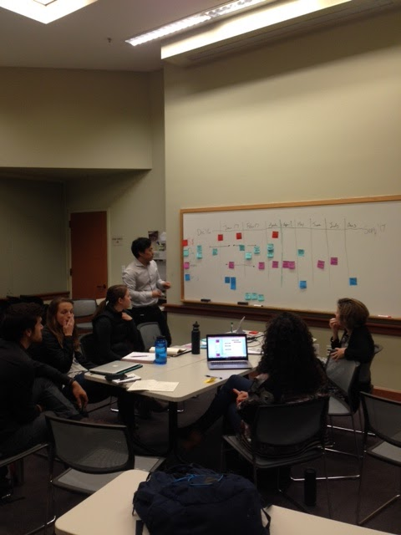
Implementation Plan
We conducted an interactive workshop to outline specific implementation steps within four main categories:
Budget
Org & Governance
Process
Tools & Reporting

Slide 37


Implementation Plan
 | Dec ‘16 | Jan ‘17 | Feb | Mar | Apr | May | June | July | Aug | Sept
Budget
Org & Governance
Process
Tools & Reporting
$ for people/ staff
$ for survey based on tech need
Oxeon go/no-go
Determine project owner
Time allocation people resources
Establish governance processes (reporting - who, how often, what info)
Confirm metrics w/ org at diff levels
Team incentives
Board intro logic model
Board survey review
Leadership buy-in on logic model
Internal training/ prof dev
Capability Areas
Communications launch
Soft org alignment
Full org alignment
Finalize list of metrics
Revise questions
Survey
test
Survey
launch
Analyze results
Develop dashboard
Midterm survey
Prepare Berkeley report
Create job description
Report & assess results
Confirm dev constraints
Determine tech capabilities (link to profile, platform vs email)
Build reporting tools & processes
Modify survey based on Oxeon
RFP tech rqmts
Determine midterm platform
Survey parameters (# Qs, recipients, reminders)

Slide 38
Appendix 1:
Survey Examples

Slide 39
Survey Examples from Benchmarks
 | Patients Like Me | Care Message #1 | Care Message #2
Outcomes Measured | User Satisfaction Changes in patient knowledge Self-reported behavior change Changes in patient activation | User Satisfaction Changes in patient activation | User Satisfaction Changes in patient knowledge Self-reported behavior change Changes in patient activation
Tools Used & Frequency | Online survey 30-40 questions 1x, after 30 days of membership | Text Message Survey 5-7 questions 1x, post intervention | Text Message Survey short , # questions n.a. 5x, during intervention, 1 month apart
Response Rate | 9% (221/2362) | 80% (80/101) | Unknown
Comments | Comprehensive, but lengthy | High-level, but quick | More laborious for administrator
Sources:
Text Messaging and Health: How a simple technology can impact the health of the medically underserved. CareMessage White Paper.
SMS Health Education Programs: Evaluating our Results CareMessage Blog. Link.
Perceived benefits of sharing health data between people with epilepsy on an online platform. Epilepsy & Behavior. Link.
Medication Adherence Texting Pilot Program. Americares. Link.

Slide 40
Example Survey: Care Message #1
The program helped me improve the self-management of my condition(s) – Likert scale (ie. Strongly agree, etc.)
I learned useful information from the text messages. Likert scale (ie. Strongly agree, etc.)
The texts were clear and easy to understand. Likert scale (ie. Strongly agree, etc.)
I did not find the text messages annoying. Likert scale (ie. Strongly agree, etc.)
Would you recommend the text-messaging program to a friend or family member? Y/N

Slide 41
Example Survey: Patients Like Me
Has PatientsLikeMe improved your understanding of:
how your condition(s) may affect you?
what might help you live better with your condition(s)?
what might help you get better?
available treatments?
treatment side effects?
the important factors in making decisions about treatments?
how to deal with other problems in your life (e.g. stress, work, money) that may be caused by your condition(s)
As a result of using PatientsLikeMe have you:
Started a new treatment
Stopped a treatment
Tried a new way to manage side effects?
Been better at taking your medication?
Managed your symptoms better?
Had better conversations with your healthcare professionals?
Changed your doctor?
How likely is it that you would recommend PatientsLikeMe to a friend or family member? 0-10
Is there anything else you would like to tell us about how PLM has had an impact on you?
*10+ demographic questions also included at end of survey
In general, would you say your health is: Excellent, very good, good, fair, poor
How often do you have difficulty remembering to take all your medications?
In general, how satisfied or dissatisfied are you with the ability of the medication you take to prevent or treat your condition(s)?
Please indicate how much you agree or disagree with each statement as it applies to you personally. Likert scale
When all is said and done, I am the person who is responsible for managing my condition(s).
Taking an active role in my own health is the most important factor in determining my health and ability to function.
I am confident that I can take actions that will help prevent or minimize some symptoms or problems associated with my health condition(s).
I know what each of my prescribed medications do.
I am confident that I can tell when I need to go get medical care and when I can handle a health problem on my own.
I am confident that I can tell my doctor concerns I have.
I understand the nature and causes of my health condition(s).
I know the different medical treatment options available for my health condition(s).
I have been able to maintain the lifestyle changes for my health condition(s) that I have made.
I know how to prevent further problems with my health condition(s).
I am confident that I can figure out solutions when new situations or problems arise with my health condition(s).
I am confident that I can maintain lifestyle changes, like diet and exercise, even during times of stress.

Slide 42
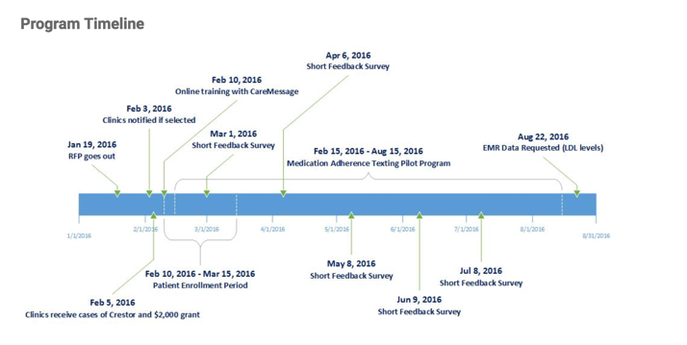
Example Survey Timeline: Care Message #2
Source:
http://www.safetynetcenter.org/medication-adherence-texting-pilot-program

Slide 43
Appendix 2:
Benchmarking

Slide 44




Literature Review and Benchmarking
Researched domains:
I. Breast cancer:
Context, main trends, organizations
II. Personalization:
Review evidence on strategy, implementation, and outcomes
Description:
We conducted a literature review and benchmarking analysis on 4 domains.
The results will complement our stakeholder understanding and data analysis.
III. Comparison industries:
Health care delivery, health information
IV. DIsparate industries
Retail (e-commerce)

Slide 45

Some Features of Leading Models
BabyCenter.com
Simple user information capture
Well organized content: by stage mainly
Partnership with an industry leader (Johnson and Johnson) to provide capacity and resources
Omada Health
Attractive design
Comprehensive information capture
Exclusiveness: application review and framing the interaction as a “commitment”
Science-based approach and outcomes
CareMessage
Streamlined interaction - different platforms
Multi-stakeholder approach: patients, government, hospitals,
Active engagement with social enterprise incubators and philanthropic foundations
Patients Like Me:
Comprehensive patient information request
Detailed information provision for patients: symptoms, treatment, perceived effectiveness
Detailed profile and potential actions to take within the community

Slide 46
Summary Findings: Breast Cancer and Personalization
Studies have revealed immense diversity in individual breast cancer cases and across cohorts of breast cancer patients.
“Personalized medicine for the routine clinical management of breast cancer patients is a lofty goal that will require expansion of our knowledge of the molecular underpinnings of this disease and its various subtypes.”
With emerging imaging techniques (ie, digital mammography, tomosynthesis, ultrasonography, magnetic resonance imaging, nuclear medicine, and genomic techniques, such as real-time RT-PCR and microarrays), breast cancer diagnostics is going through a significant evolution.
Four main opportunities have been identified in the literature to move forward in breast cancer treatments:
Personalized: knowledge of patient’s genetic profile leads to proper medication or therapy
Preventive: offers the opportunity to act on the disease through early intervention
Predictive: enables physicians to select optimal therapies + avoid adverse drug reactions.
Participative: personalized medicine = increase in patient adherence to treatment
Personalized medicine promises to increase the quality of clinical care and, in some cases, to decrease health care costs. The biggest hurdles are economic [incentives and institutions], not scientific.

Slide 47
Summary Findings: Comparison Industries
Benchmarking comparison industries illustrates the magnitude of the challenge for implementing a personalization strategy within the healthcare space.
The analyzed platforms aim at controlling a wide range of variables at play to produce effective behavioral change, such as peers, community, expert advice, accountability, timely information, compelling message, attractive design, among others.
A strong combination of a clear strategy (particularly outcomes), sound financial and human resources, and advanced technological capabilities seem to be at play.
Partnerships with industry players (ex.: private companies) and with funders (ex.: social enterprise incubators) appears to be a driving force in this processes.

Slide 48
Summary Findings: Comparison Industries
BabyCenter.com
Simple user information capture
Well organized content, mainly by stage
Partnership with an industry leader (Johnson and Johnson) to provide capacity and resources
Omada Health
Attractive design
Comprehensive information capture
Exclusiveness: application review and framing the interaction as a “commitment”
Science-based approach and outcomes
CareMessage
Streamlined interaction - different platforms
Multi-stakeholder approach: patients, government, hospitals,
Active engagement with social enterprise incubators and philanthropic foundations
Patients Like Me:
Comprehensive patient information request
Detailed information provision for patients: symptoms, treatment, perceived effectiveness
Detailed profile and potential actions to take within the community

Slide 49

Summary Findings: Disparate Industries
6 Things Online Retailers can Learn from Amazon:
The power of speed page: “The time it takes for a webpage to load can have a large impact on user experience and sales.”
The power of personalization: “This may be easier said than done but many common ecommerce platforms offer 3rd party addons to provide similar functionality. An easier alternative involves showing users recently viewed products.”
Make searching a breeze: “The search bar can have a significant impact on the user experience”.
Users need reviews: “Users rely on product reviews to make informed decisions before purchasing an item.”
Recommend similar products: “Focusing on average order value is often one of the easiest yet overlooked ways to improve sales.”
Test, Test, Test: “Test everything. The success of Amazon can largely be contributed to the company’s culture to always test new ideas. Amazon’s CEO Jeff Bezos once said ‘If you double the number of experiments you do per year you’re going to double your inventiveness.’”
Extracted from:
http://www.forbes.com/sites/groupthink/2013/09/24/6-things-online-retailers-can-learn-from-amazon/#26af8a7353b8

